Slide 1







Wave, Wave, Wave the Flag
As we march around
Hold it high to show our pride
It must not touch the ground
Wave, Wave, Wave the Flag
Dear red, white and blue
Stars and Strips forever bright
America to you!

Slide 2




A - M - E - R - I - C - A
I
I LOVE AMERICA EV’RY DAY
I
IF YOU LOVE AMERCIA LIKE I DO
I
YOU CAN SING A SONG, AND I'LL SING WITH YOU
Repeat
3 times
OH, I LOVE AMERICA
I DO, I DO, I DO
Back to the beginning

Slide 3
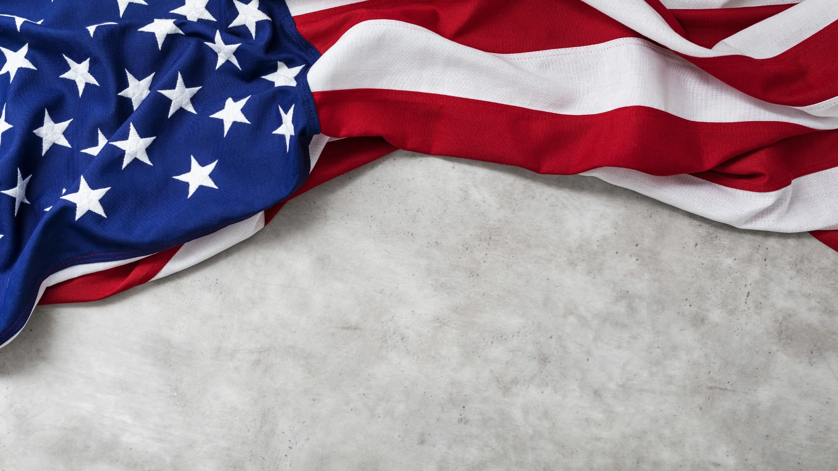

Slide 4



FREEDOOM, FREEDOM, I AM FREE
FREEDOOM, FREEDOM, I AM FREE
FREEDOOM, FREEDOM, I AM FREE
I’M AMERICAN !

Slide 5
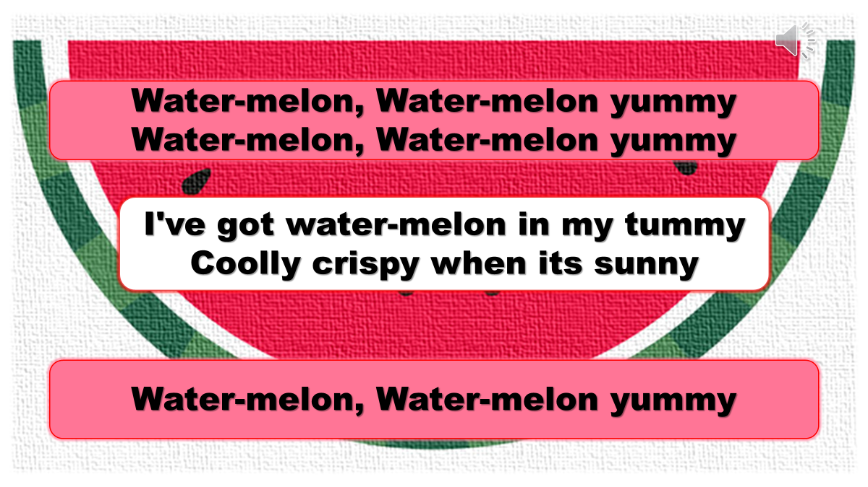


Slide 6
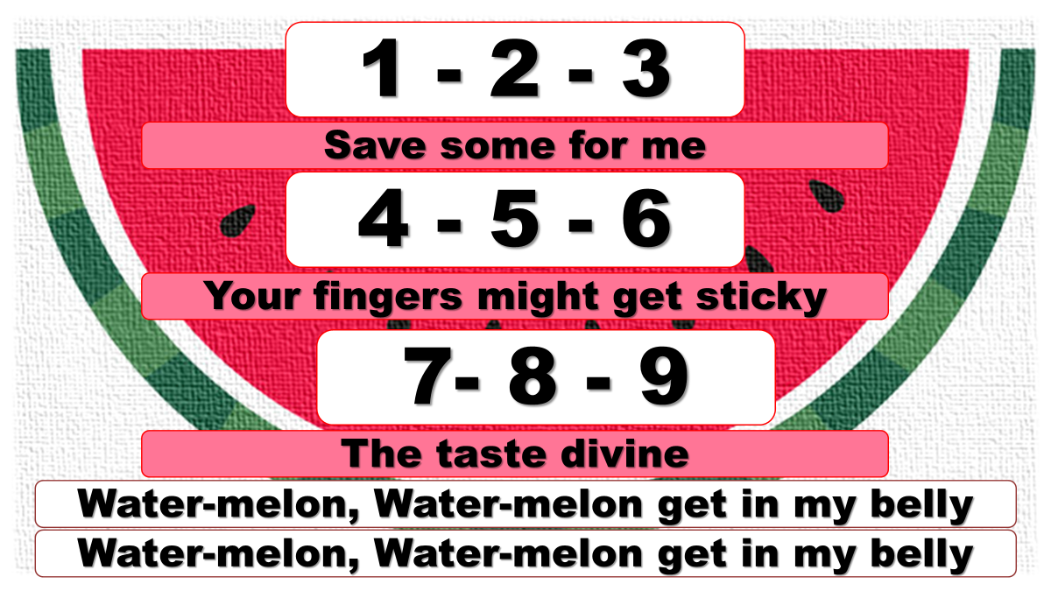

Slide 7
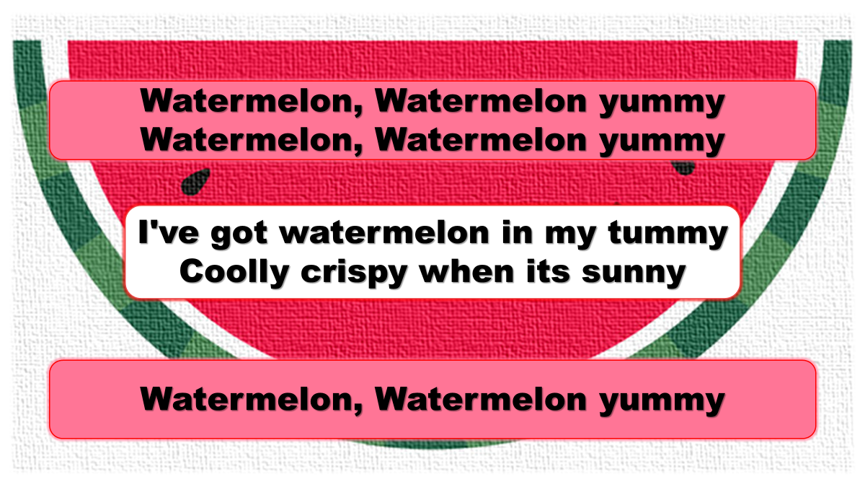

Slide 8
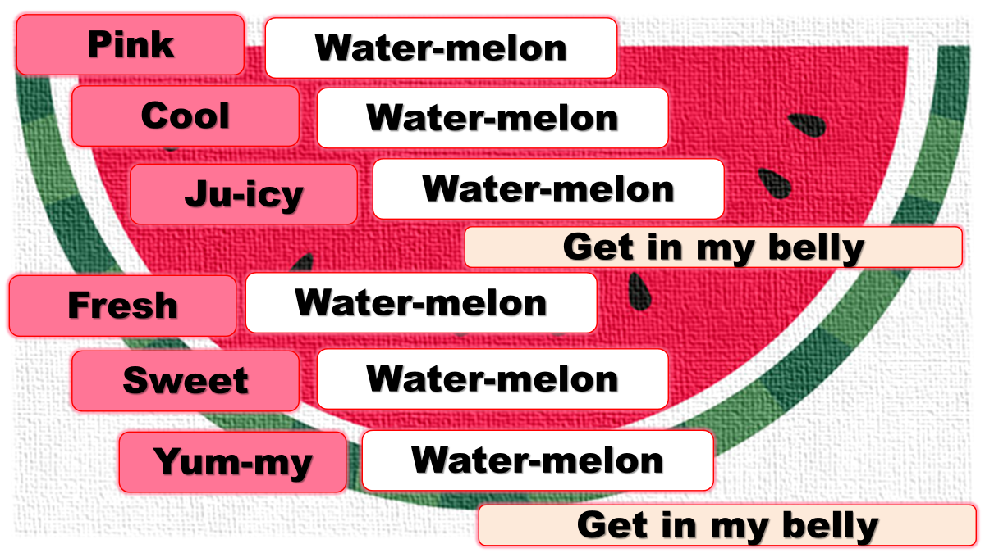

Slide 9
